Slide 1

Introduction to the Revit ® 2011 API - Part 2
Saikat Bhattacharya
Developer Consultant

Slide 2

About the Presenter
Saikat Bhattacharya
Developer Technical Services
Autodesk India
Saikat is a member of the AEC workgroup within the Developer Technical Services (DevTech) team in Autodesk. He has been associated with Autodesk for 6 years now and was working with Autodesk Consulting before joining DevTech. Prior to joining Autodesk, Saikat worked as GIS software developer in Philadelphia and as a project architect in the construction industry in New Delhi.
Saikat holds a Bachelors degree in Architecture (India) and a Masters of Science degree in Informatics and Architecture from RPI.

Slide 3
This class is in continuation to…
Introduction to Revit API – Part 1
(By Adam Nagy, Developer Consultant)

Slide 4
Agenda
UI Topics
Ribbon
User Selection
Task dialog
Events
Dynamic model update

Slide 5
Ribbon API
How to modify the UI

Slide 6
Ribbon API Overview
The Ribbon API is the only GUI customization API
Menus and toolbars need to be migrated to ribbon
Easy to use
No WPF knowledge needed
Guidelines provided
Ribbon design guidelines.pdf
Autodesk Icon Guidelines.pdf
Notes:
As we have seen earlier, Revit 2010 has a completely new look with a ribbon based UI. Unlike AutoCAD based products, this change is not optional. There is no way to turn this off and switch back to the old UI. If you used toolbars in Revit 2009 and earlier, you will need to migrate your application to use the ribbon.
The Ribbon API is available to add custom ribbon panels, add various types of UI widgets on the ribbon panel.
This API is quite straight-forward to use. There is no need to learn WPF, for example.
In addition to the programming aspect, there is documentation with guidelines for designing your custom ribbon and icons. This is to ensure that your application is nicely integrated with Revit UI. The documentation in the SDK folder:
Ribbon design guidelines.pdf
Autodesk Icon Guidelines.pdf

Slide 7
Ribbon API Overview
Custom ribbon panels located on the Add-Ins tab but can also be placed on the Analyze tab.
Custom ribbon tab cannot be created
External commands under External Tools
External applications on custom ribbon panel
Push button
Pull-down button
Single or stacked layout with two or three rows
Split button (new!)
Radio Group (new!)
Combo box (new!)
Text box (new!)
SlideOut panel (new!)
Notes:
At the moment, we cannot create a separate ribbon tab. All External Application and External Command related user interface items are placed on the Add-Ins Tab by default but can also be placed in Analyze tab. You see this tab when you add an external application or command section to the manifest or the ini file. External commands are listed under the External Tools button. External applications can create their own ribbon panels.
Panels can include
buttons, both large and small, which can be either simple push buttons,
pulldown buttons containing multiple commands, or
split buttons which are pull-down buttons with a default push button attached.
radio groups,
combo boxes
and text boxes.
Panels can also include vertical separators to help separate commands into logical groups. Panels can also include a slide out control which can be accessed by clicking on the bottom of the panel.

Slide 8
Ribbon API Classes
RibbonPanel
A ribbon panel in the Add-Ins/Analyze tab
A panel contains a number of ribbon items or buttons
RibbonItem
A button, push or pull-down, ComboBox, TextBox, RadioButton, etc
PushButton, PushButtonData
Manage push button information
PulldownButton, PulldownButtonData
Manage pull-down button information
SplitButton, SplitButtonData
Manage split button information
ComboBox, ComboBoxData
Manage combo box information
…
Notes:
The RibbonItem object represents an item on RibbonPanel, can be a push-button or a pull-down which should contain the information for creating one RibbonItem.
Each ribbon control has two classes associated with it – one derived from RibbonItemData that is used to create the control (i.e. SplitButtonData) and add it to a ribbon panel and one derived from RibbonItem (i.e. SplitButton) which represents the item after it is added to a panel. The properties available from RibbonItemData (and the derived classes) are also available from RibbonItem (and the corresponding derived classes). These properties can be set prior to adding the control to the panel or can be set using the RibbonItem class after it has been added to the panel.

Slide 9
Ribbon API What’s new in 2011
New namespace
Autodesk.Revit.UI
New Widgets (SplitButton, ComboBox, TextBox, etc)
New events for ComboBox and TextBox
New properties
RibbonItem.Visible
RibbonItem.LongDescription
RibbonItem.ToolTipImage
PushButton.AvailabilityClassName
Some pre-existing APIs changed (AddButtons -> AddItems, etc)
Notes:
There are new Ribbon components supported via the Ribbon API:
SplitButton - a pulldown button with a default pushbutton attached
RadioGroup - a set of ToggleButtons, where only one of the set can be active at a time
ComboBox - a pulldown containing a set of selectable items, which can be grouped optionally
TextBox - an input field for users to enter text
SlideOut panel - an extra panel can optionally slide down from a Ribbon panel; this panel can contain any of the standard Ribbon components
For ComboBox and TextBox, events are included; these events call your API code when the component is changed by the user.
The new property:
RibbonItem.Visible : provides control over whether a particular item is visible.
RibbonItem.LongDescription
RibbonItem.ToolTipImage : allow you to set up an extended tooltip for the Ribbon item. This tooltip can display a longer set of text, and/or a single image.
PushButton.AvailabilityClassName : allows assignment of an availability class to controlled whether or not the button is available, similar to the option provided for ExternalCommands registered by manifest.
There is also a new option to add custom panels to the Analyze tab in Revit as well as the Add-Ins tab, via a new enumeration overload of Application.CreateRibbonPanel().
As a result of these enhancements, some pre-existing APIs have changed:
RibbonPanel.AddButton() has been replaced with RibbonPanel.AddItem()
RibbonPanel.AddStackedButtons() overloads have been replaced with RibbonPanel.AddStackedItems() overloads
Property RibbonPanel.Items has been replaced with method RibbonPanel.GetItems()
Property PulldownButton.Items has been replaced with method PulldownButton.GetItems()
Methods RibbonPanel.AddPushButton() and RibbonPanel.AddPulldownButton() have been removed. Use RibbonPanel.AddItem() for this operation.
RibbonPanel.AddToPulldown() has been removed. Use PulldownButton.AddItem() for this operation.
PulldownButton.AddPushButton() has been removed. Use PulldownButton.AddItem() for this operation.

Slide 10
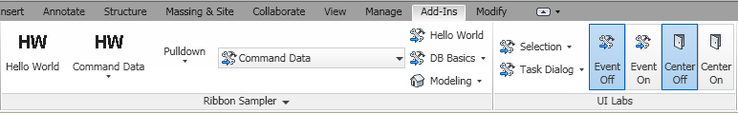
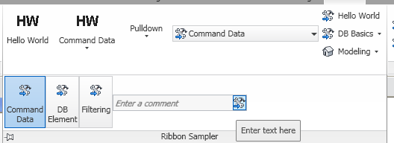
Lab - Ribbon API

Slide 11
User Selection
Point and object(s) selection using the API

Slide 12
User Selection Overview
Ability to select Object(s), Point, Edge and Face
Add new selection to active collection using:
PickObject()
PickObjects()
PickElementsByRectangle()
PickPoint()
UIDocument uidoc = new UIDocument(document);
Selection choices = uidoc.Selection;
// Choose objects from Revit.
IList<Element> hasPickSome = choices.PickElementsByRectangle("Select by rectangle");
if (hasPickSome.Count > 0)
{
int newSelectionCount = choices.Elements.Size;
string prompt = string.Format("{0} elements added to Selection.",
newSelectionCount - selectionCount);
TaskDialog.Show("Revit", prompt);
}
Notes:
The Selection class has methods for allowing the user to select objects (single or multiple selection) or even a point on screen. This allows the user to select one or more Elements (or other objects, such as an edge or a face) using the cursor and then returns control to your application. These functions do not automatically add the new selection to the active selection collection.
The PickObject() method prompts the user to select an object in the Revit model.
The PickObjects() method prompts the user to select multiple objects in the Revit model.
The PickElementsByRectangle() method prompts the user to select multiple elements using a rectangle, what is often also known as box select.
The PickPoint() method prompts the user to pick a point in the active sketch plane and this returns the XYZ value corresponding to the picked point.

Slide 13
User Selection Overview
Ability to specify type of object
Element, PointOnElement, Edge, Face
Ability to add custom status messages
StatusbarTip
Ability to define snap types for selection
Ability to set the active workplane
View.SketchPlane()
public void PickPoint(UIDocument uidoc)
{
ObjectSnapTypes snapTypes = ObjectSnapTypes.Endpoints | ObjectSnapTypes.Intersections;
XYZ point = uidoc.Selection.PickPoint(snapTypes, "Select an end point or intersection");
string strCoords = "Selected point is " + point.ToString();
TaskDialog.Show("Revit", strCoords);
}
Notes:
The type of object to be selected is specified when calling PickObject() or PickObjects. Types of objects that can be specified are: Element, PointOnElement, Edge or Face.
We can also add custom status messages to the pick functions prompting users on what needs to be selected or picked. This is done using the StatusbarTip. Each of the Pick functions has an overload that has a String parameter in which a custom status message can be provided.
With this API, we also have the ability to define the snap settings (or types) during selection. PickPoint() method also has 2 overloads with ObjectSnapTypes parameter which is used to specify the snap types used for selection.
We can also set the active work-plane with the View.SketchPlane() so that we have control on the point that we are having the user select, thus, enhancing the UI experience using the API.

Slide 14
User Selection Selection Filter
ISelection Interface to help filter objects during selection
AllowElement()
AllowReference()
public void SelectPlanarFaces(Autodesk.Revit.DB.Document document)
{
UIDocument uidoc = new UIDocument(document);
ISelectionFilter selFilter = new PlanarFacesSelectionFilter();
IList<Reference> faces = uidoc.Selection.PickObjects(ObjectType.Face, selFilter, "Select multiple planar faces");
}
public class PlanarFacesSelectionFilter : ISelectionFilter
{
public bool AllowElement(Element element)
{
return true;
}
public bool AllowReference(Reference refer, XYZ point)
{
if (refer.GeometryObject is PlanarFace) { return true; }
return false;
}
}
Notes:
The user selection API allows API users to filter objects during the selection. The element or object selection – single and multiple selection methods, all have overloads that take an ISelectionFilter as a parameter. And it is this ISelectionFilter interface that enables the filtration of objects during a selection operation. It has two methods that can be overridden: AllowElement() which is used to specify if an element is allowed to be selected, and AllowReference() which is used to specify if a reference to a piece of geometry is allowed to be selected.
The code snippet included in the slide demonstrates the use of ISelectionFilter to allow selection of planar faces only.

Slide 15
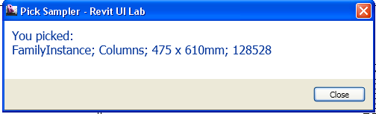
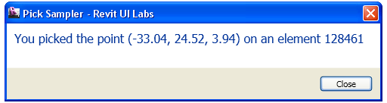
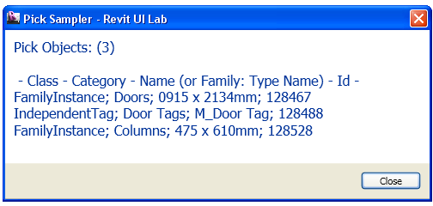
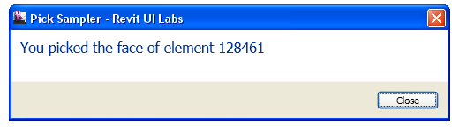
Lab - User Selection Pick Sampler

Slide 16
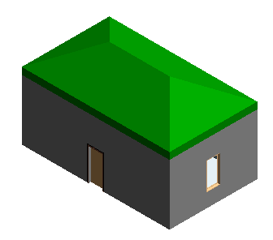
Lab - User Selection Create House Pick
<CS>
XYZ pt1 = rvtUIDoc.Selection.PickPoint("Pick the first corner of walls");
XYZ pt2 = rvtUIDoc.Selection.PickPoint("Pick the second corner");
//' simply create four walls with orthogonal rectangular profile from the two points picked.
List<Wall> walls = RevitIntroVB.ModelCreation.CreateWalls(rvtUIDoc.Document, pt1, pt2);
//' pick a wall to add a front door
SelectionFilterWall selFilterWall = new SelectionFilterWall();
Reference @ref = rvtUIDoc.Selection.PickObject(ObjectType.Element, selFilterWall, "Select a wall to place a front door");
Wall wallFront = @ref.Element as Wall;
//' add a door to the selected wall
RevitIntroVB.ModelCreation.AddDoor(rvtUIDoc.Document, wallFront);
</CS>

Slide 17
Task Dialogs
Revit styled message boxes

Slide 18
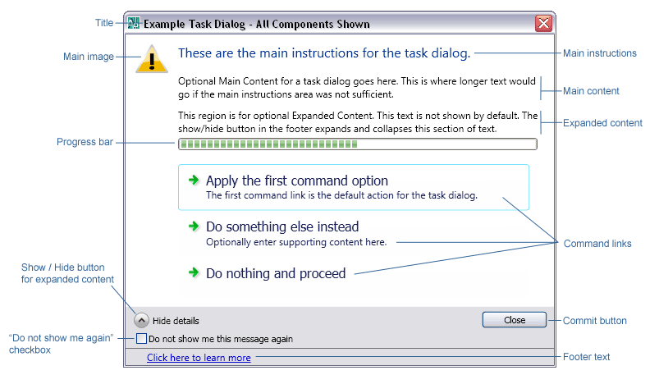
Task Dialogs Overview
A modal dialog with set of controls
Revit style alternative to simple Windows message box.
Used when system needs to
Provide information
Ask a question
Allow users to select options to perform task
Notes:
A TaskDialog is a modal dialog with a set of controls and is the Revit-styled alternative to a simple Windows MessageBox. It can be used to display information and receive simple input from the user. It has a common set of controls that are arranged in a standard order to assure consistent look and feel with the rest of Revit user interface.
Task dialogs cannot display other controls such as, text inputs, list boxes, combo boxes, check boxes, etc. They also only accommodate single step, single action operations; meaning a user may make a single choice and complete the task dialog operation. As a result any dialog that requires such additional controls or multiple steps operations (as with a wizard) would need to be implemented as custom dialogs using .NET controls to have a similar look & feel to Task Dialogs.

Slide 19
Task Dialog Overview
Two ways to create task dialogs:
Construct TaskDialog, set properties and use instance method Show()
Instance of Autodesk.Revit.UI.TaskDialog
Use one of the static Show() methods to show in one step
And use it to set
instructions,
detailed text,
icons,
buttons
command links
Verification text, etc
Notes:
There are two ways to create and show a task dialog to the user. The first option is to create a new instance of the TaskDialog, set its properties individually, and use the instance method Show() to show it to the user. The second is to use one of the static Show() methods to construct and show the dialog in one step. When you use the static methods only a subset of the options can be specified.
And task dialogs can be used to set instructions, detailed text, icons, buttons, command links, verification texts, etc.

Slide 20
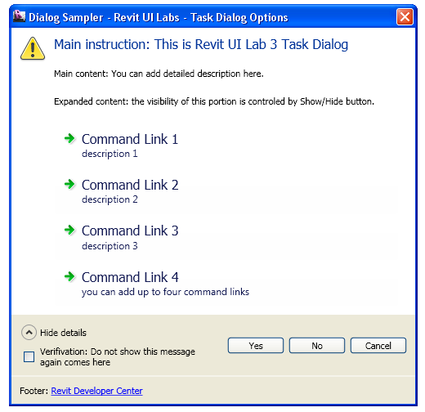
Lab - Task Dialog Dialog Sampler
<CS>
//' (0) create an instance of task dialog to set more options.
TaskDialog myDialog = new TaskDialog("Revit UI Labs - Task Dialog Options");
//' (1) set the main area. these appear at the upper portion of the dialog.
//'
myDialog.MainIcon = TaskDialogIcon.TaskDialogIconWarning;
//' or TaskDialogIcon.TaskDialogIconNone.
myDialog.MainInstruction = "Main instruction: This is Revit UI Lab 3 Task Dialog";
myDialog.MainContent = "Main content: You can add detailed description here.";
if (stepByStep) myDialog.Show();
</CS>

Slide 21
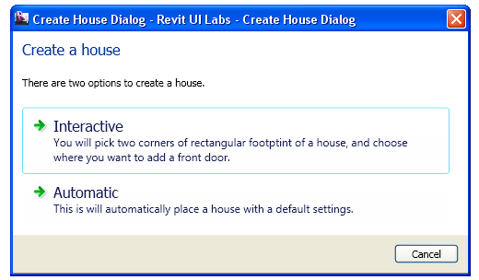
Lab - Task Dialog Create House Dialog
<CS>
TaskDialog houseDialog = new TaskDialog("Revit UI Labs - Create House Dialog");
houseDialog.MainInstruction = "Create a house";
houseDialog.MainContent = "There are two options to create a house.";
houseDialog.AddCommandLink(TaskDialogCommandLinkId.CommandLink1, "Interactive", "You will pick two corners of rectangular footprint of a house, and choose where you want to add a front door.");
houseDialog.AddCommandLink(TaskDialogCommandLinkId.CommandLink2, "Automatic", "This is will automatically place a house with a default settings.");
houseDialog.CommonButtons = TaskDialogCommonButtons.Cancel;
houseDialog.DefaultButton = TaskDialogResult.CommandLink1;
//' show the dialog to the user.
TaskDialogResult res = houseDialog.Show();
</CS>

Slide 22
Events and Dynamic Model Update
Application, Document and Element events

Slide 23
Events Overview
Notifications triggered on specific actions
Complaint to .NET event standard
Pre and Post events
Single event (DocumentChanged and FailureProcessing)
Currently not supported in VSTA
Types :
Application level
Document level
Notes:
Events are notifications that are triggered on specific actions in the Revit user interface or API workflows. By subscribing to events, an add-in application can be notified when an action is about to happen or has just happened and take some action related to that event.
Since Revit 2010, the events API is .NET complaint. Some events come in pairs around actions, one occurring before the action takes place (―pre event) and the other happening after the action takes place (―post event). Events that do not occur in these pre/post pairs are called ―single events.
Events are not supported in VSTA.
Revit provides access to events at both the Application level (such as ApplicationClosing or DocumentOpened) and the Document level (such as DocumentClosing and DocumentPrinting).
The same application level events available from the Application class are also available from the ControlledApplication class, which represents the Revit application with no access to documents. It is ControlledApplication that is available to add-ins from the OnStartup() and OnShutdown() methods.

Slide 24
Events Overview
Also Classified as DB and UI events
DB events available from Application and Document classes
UI events available from UIApplication class
Edit model during events using
Document.IsModifiable
Document.IsReadOnly
Many of the new pre-events are cancellable
RevitEventArgs.Cancellable
RevitAPIPreEventArgs.Cancel
Notes:
Events can also be categorized as database (DB) events or user interface (UI) events. DB events are available from the Application and Document classes, while UI events are available from the UIApplication class. (Currently all UI events are at the application level only).
UI events include ApplicationClosing, DialogBoxShowing, Idling, ViewActivating, ViewActivated.
Some events are considered read-only, which means that during their execution the model may not be modified. The fact that an event is read-only is documented in the API help file. It is important to know that even during regular events (i.e. not read-only events), the model may be in a state in which it cannot be modified. The programmer should check the properties Document.IsModifiable and Document.IsReadOnly to determine whether the model may be modified.

Slide 25
Events Event Handler, Registering and Unregistering events
EventHandler
Registering events
Unregistering events
public void UILabs_DocumentChanged(object sender, DocumentChangedEventArgs args)
{
// Do something here
}
public Result OnStartup(UIControlledApplication application)
{
application.ControlledApplication.DocumentChanged += UILabs_DocumentChanged;
return Result.Succeeded;
}
public Result OnShutdown(UIControlledApplication application)
{
application.ControlledApplication.DocumentChanged -= UILabs_DocumentChanged;
return Result.Succeeded;
}
Notes:
First, you must have a function that will handle the event notification. This function must take two parameters, the first is an Object that denotes the ―sender of the event notification, the second is an event-specific object that contains event arguments specific to that event. For example, to register the DocumentSavingAs event, your event handler must take a second parameter that is a DocumentSavingAsEventArgs object.
The second part of using an event is registering the event with Revit. This can be done as early as in the OnStartup() function through the ControlledApplication parameter, or at any time after Revit starts up through external commands.

Slide 26
Events What’s new in 2011
Change in namespaces
Autodesk.Revit.DB.Events
Autodesk.Revit.UI.Events
New Event
Document.Changed
UIApplication.Idling
Notes:
The new event Application.DocumentChanged is raised after every transaction gets committed, undone, or redone. This is a readonly event, designed to allow you to keep external data in synch with the state of the Revit database. To update the Revit database in response to changes in elements, use the Dynamic Model Update framework.
The event handler receives a DocumentChangedEventArgs instance as an input argument which provides information on the operation performed and the document and elements involved. Some of its most important properties and methods are therefore the following:
Operation: the operation associated with this event.
GetDocument: the document associated with this event.
GetAddedElementIds: the set of elements newly added to the document.
GetDeletedElementIds: the set of elements that were deleted.
GetModifiedElementIds: the set of elements that were modified.
GetTransactionNames: the names of the transactions associated with this event.
The new event UIApplication.Idling is raised when it is safe for the API application to access the active document between user interactions. This event is raised only when the Revit UI is in a state where the user could successfully click on an API command button.
Handlers of this event are permitted to make modifications to any document (including the active document), except for documents that are currently in read-only mode.
In order to change a document, users must begin a new transaction for that document. This transaction will appear in the Revit undo stack and may be undone by the Revit user.
Because this event is invoked between user actions in the Revit UI, if the handler for this event requires a significant amount of processing time, users will perceive a slowdown in the responsiveness of Revit. If the execution for updates can be safely split across multiple calls to this event, the user perception of Revit responsiveness will be improved.

Slide 27
Events What’s new in 2011
No longer automatic open transactions with events
Deprecated the Pre-Revit 2010 events
Application.OnDocumentSaved
Application.OnDocumentSavedAs
Application.OnDocumentOpened
Application.OnDocumentClosed
Application.OnDocumentNewed
Application.OnDialogBox
Document.OnSaveAs
Document.OnSave
Document.OnClose
Notes:
All events have been changed to no longer automatically open transactions like they originally did in earlier releases. As a result of this new policy, the document will not be modified during an event unless one of the event’s handlers modifies it by making changes inside a transaction. A transaction may be opened by either the event handler if there is no transaction already opened (sometimes when the event is invoked, there is already a transaction open). If an event handler opens a transaction it is required that it will also close it (commit it or roll it back), otherwise all eventual changes will be discarded.
Please be aware that modifying the active document is not permitted during some events (e.g. the DocumentClosing event). If an event handler attempts to make modifications during such an event, an exception will be thrown. The event documentation indicates whether or not the event is read-only.

Slide 28
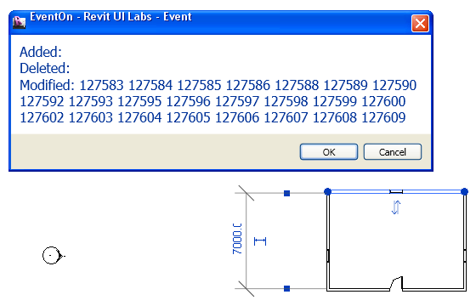
Lab - Events
//' register the document changed event
application.ControlledApplication.DocumentChanged += UILabs_DocumentChanged;
//' you can get the list of ids of element added/changed/modified.
Document rvtdDoc = args.GetDocument();
ICollection<ElementId> idsAdded = args.GetAddedElementIds();
ICollection<ElementId> idsDeleted = args.GetDeletedElementIds();
ICollection<ElementId> idsModified = args.GetModifiedElementIds();
//' put it in a string to show to the user.
string msg = "Added: ";
foreach (ElementId id in idsAdded)
{
msg += id.IntegerValue.ToString() + " ";
}

Slide 29
Dynamic Model Update Overview
“Ability for a Revit API application to modify the Revit model as a reaction to changes happening in the model”.
Helps track element addition, modification and deletion
Notes:
Dynamic model update offers the ability for a Revit API application to modify the Revit model as a reaction to changes happening in the model. Application.DocumentChanged event is read-only event and thus it does not support modification to Revit database. For that, we can use the DMU mechanism.
With this mechanism, Revit will now let you know when elements are added, modified or deleted.
One important thing to note is that this facility allows the application to perform its changes to react to the notification within the same transaction as the one that triggered the changes. Thus this enables you to edit the model during the model regeneration cycle triggered by the element change. For example – if the user stretches a concrete beam and our application is based on rebars, we can modify the rebar within the beam right after the users are done with resizing the beam. And those changes to the model will be contained in that overall transaction, and so if the user does an undo, our rebar sizing and the beam resizing will all be done at once in one shot (instead of having a clunky two stage resizing). This has lot of implication since we are now able to react to events in model and we can update our analysis applications, or make changes in the model in reaction to users interaction to the model elements.

Slide 30
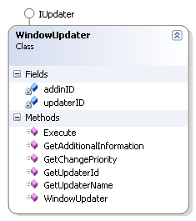
Dynamic Model Update Updaters
Updaters :
Ability to implement a method that is informed of the scope of changes
Implements the IUpdater interface.
GetUpdaterId ()
GetUpdaterName()
GetAdditionalInformation ()
GetChangePriority()
Execute()
Notes:
The ability to track and modify the model as a reaction to changes in the model, is offered through implementation of updaters. The updater interface offers the ability to implement a method that is informed of the scope of changes that triggered the changes.
Updaters are classes which implement IUpdater interface. So as our next step, we shall create Updater class and implement the IUpdater interace in it. This interface implementation includes some methods like -
GetUpdaterId – This method returns the unique id of the updater which includes the application Id and a GUID for this updater. This is used when Revit remembers the details about the updater which drives a set of elements in the document and is called once during the registration of the Updater.
GetUpdaterName – This method returns the name by which the updater can be identified by the user, in case there is any problem with the Updater at runtime.
GetAdditionalInformation – This method returns the auxiliary strings which are displayed in situations when the updater (that was used to drive the document) is not present or not loaded.
GetChangePriority – This method identifies the nature of the changes the Updater will be performing. It is used to identify the order of execution of updaters and called once during the registration of the Updater.
And Execute – this method is updated of the scope of the changes that triggered the update and allows API users to make changes of its own to the elements in the document.
If a document is modified by an Updater, the document will store the unique Id of the updater. If the user later opens the document and the Updater is not present, Revit will warn the user that the 3rd party updater which previously edited the document is not available.

Slide 31
Dynamic Model Update Registration and Triggers
Register the Updater
OnStartUp for application level scope
ExternalCommand for command level scope
Add Trigger
Change of Scope - list of ElementIds or list of elements via ElementFilter.
Change of Type - addition, deletion and modification
WindowUpdater updater = new WindowUpdater(application.ActiveAddInId );
// Register the updater in the singleton UpdateRegistry class
UpdaterRegistry.RegisterUpdater( updater );
// Set the filter
ElementClassFilter filter = new ElementClassFilter( typeof( Wall ) );
// Add trigger
UpdaterRegistry.AddTrigger(updater.GetUpdaterId(),filter, Element.GetChangeTypeGeometry());
Notes:
The next step is to register the Updater class in the onStartUp method of the external application. We create a new instance of the Updater class. Using the application level singleton UpdaterRegistry class which stores all the registered Updaters, we can use its RegistryUpdater() method to register the Updater object.
The process of subscribing an Updater is done using update triggers. Update triggers are combination of “Change Scope” and “Change Type”. Change Scope may either be an explicit list of element Ids or an implicit list of elements communicated via the ElementFilter. Change Type represents one of possible changes including element addition, deletion and modification of geometry, parameters or any property of the element.

Slide 32
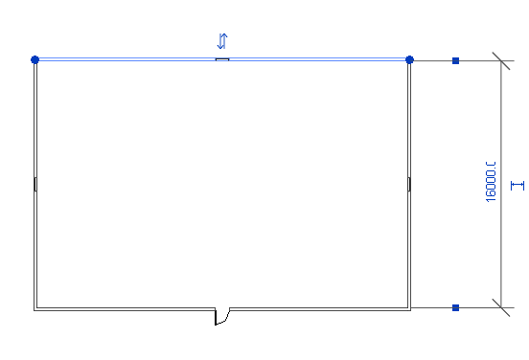
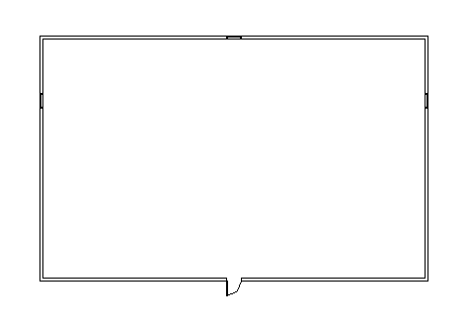
Lab - Dynamic Model Update
//' construct our updater.
WindowDoorUpdater winDoorUpdater = new WindowDoorUpdater(application.ActiveAddInId);
//' ActiveAddInId is from addin menifest.
//' register it
UpdaterRegistry.RegisterUpdater(winDoorUpdater);
//' tell which elements we are interested in notified.
//' we want to know when wall changes it's length.
//'
ElementClassFilter wallFilter = new ElementClassFilter(typeof(Wall));
UpdaterRegistry.AddTrigger(winDoorUpdater.GetUpdaterId(), wallFilter, Element.GetChangeTypeGeometry());
Notes:
In this lab, after registering the Updater, we need to add triggers to complete the Updater subscription process. The change of scope for the trigger in this case is an implicit list of elements (walls in this case since we want to trap the change of length of any wall in the model) and this is communicated via the ElementClassFilter. The change type part of the trigger represents the element modification which is mentioned using the Element.GetChangeTypeGeometry. Finally, we use the Singleton UpdaterRegistry class again and use its AddTrigger() method to add the trigger. This trigger expects the updater Id, change scope information (filter) and the change type information (where it is element addition, deletion or modification) as parameters.

Slide 33
Conclusion
Where do we go next …

Slide 34
We have covered…
UI Topics
Ribbon
User Selection
Task dialog
Events
Dynamic model update

Slide 35
Learning More
Online Help, Developer's Guide and SDK Samples
Recording of Revit API Webcast
http://www.adskconsulting.com/adn/cs/api_course_sched.php
What’s new in 2011, Family API, MEP, etc.
Discussion Groups
http://discussion.autodesk.com > Revit Architecture > Revit API
API Training Classes
http://www.autodesk.com/apitraining
The Building Coder, Jeremy Tammik's Revit API Blog
http://thebuildingcoder.typepad.com
Autodesk Developer Network
http://www.autodesk.com/joinadn
DevHelp Online for ADN members
http://adn.autodesk.com

Slide 36
Thank you!
Thank you very much for your interest and attention!
Much success with the Revit API and your application development!

Slide 37

End of Presentation

